Slide 1
Asmaa Mansour Ahmed
( Demonstrator of genetics and genetic engineering, faculty of agriculture benha university )
Genetics level two (cytology)
For programs :
Biotechnology

Slide 2
Compare the mutated flies to the normal flies
Sec 4

Slide 3
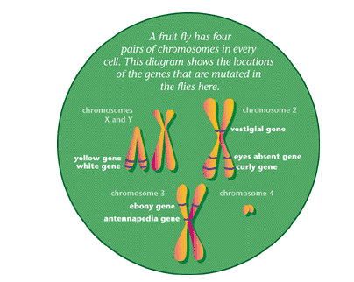
The fruit flies show just a few of the mutations that occur in natural fruit fly populations.
The genetic instructions to build a fruit fly-or any other organism-are imprinted in its DNA, a long, thread like molecule packaged in bundles called chromosomes. each chromosome consists of many individual sections called genes.
Each gene carries some of the instructions for building one particular characteristic of an organism.
To build a complete organism,
many genes must work
precisely together.
A defect in a gene can cause a change
in the building plan for one particular
body part-or for the entire organism.

Slide 4
Mutations are neither good nor bad: some may be beneficial for an organism; others may be lethal.
By creating new gene versions, mutations are a driving force for changes in evolution, sometimes leading to new species.
Biologists learn about the proper function of any gene by studying mutations.
If a defective gene causes short wings, for instance, scientists know that the healthy version of the gene is responsible for correct wing formation.

Slide 5
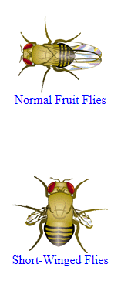
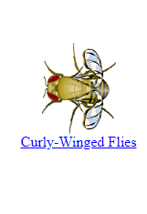
Altered wing structure
These are normal fruit flies, or "wildtypes." Notice the shape and length of their wings. Now compare them with the other fruit flies here.
The shortened wings of these flies. Flies with vestigial wings cannot fly: they have a defect in their "vestigial gene," on the second chromosome. These flies have a recessive mutation. Of the pair of vestigial genes carried by each fly (one from each parent), both have to be altered to produce the abnormal wing shape.
The curled wings of these flies. They have a defect in their "curly gene," which is on the second chromosome. Having curled wings is a dominant mutation, which means that only one copy of the gene has to be altered to produce the defect. In fact, if both copies are mutated, the flies do not survive.

Slide 6
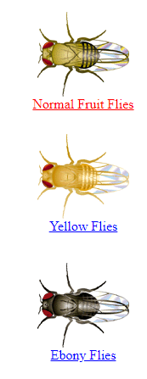
Abnormal body color
Normal Fruit Flies
These normal fruit flies, or "wildtypes," have black-and-tan striped bodies. Compare them with the other fruit flies here.
Yellow Flies
Notice that these flies are yellower than normal flies. They have a defect in their "yellow gene," which is on the X chromosome. Since the yellow gene is needed for producing a fly's normal black pigment, yellow mutant flies cannot produce this pigment.
Ebony Flies
Notice that these flies have a dark, almost black, body. They carry a defect in their "ebony gene," on the third chromosome. Normally, the ebony gene is responsible for building up the tan-colored pigments in the normal fruit fly. If the ebony gene is defective, the black pigments accumulate all over the body

Slide 7
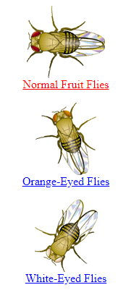
Odd colored eyes
Normal Fruit Flies
These are normal fruit flies, or "wildtypes." Notice that their eye color is bright red. Compare them with the other fruit flies here.
Orange-Eyed Flies
Notice that these flies have orange eyes. They have a defect in their "white" gene, which normally produces the red pigments in the eye. In these flies, the white gene only works partially, producing fewer red pigments than it should.
White-Eyed Flies
These flies have white eyes. Like the orange-eyed flies, they also have a defect in their "white" gene. But in these flies, the white gene is totally defective: it produces no red pigment at all.

Slide 8
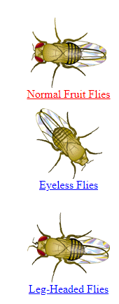
Strangely formed head
Normal Fruit Flies
These are normal fruit flies, or "wildtypes." Notice the antennas sticking out in front of their red eyes. Compare these flies to the other fruit flies here.
Eyeless Flies
Notice that these flies have no eyes. They have a defect in their "eyes absent" gene, which normally instructs cells in the larvae to form an eye.
Leg-Headed Flies
Notice that these flies have abnormal, leg-like antennas on their foreheads. They have a defect in their "antennapedia" gene (Latin for "antenna-leg"), which normally instructs some body cells to become legs. In these flies, the antennapedia gene falsely instructs cells that would normally form antenna to become legs instead

